Slide 1



Peckham Pantry Social Impact Workshop
Josh Meek

Slide 2
Agenda: 2nd July
Agenda Item | Time | Notes
Review of existing Pecan impact management practices | 12:30 – 13:00 | Josh and Chris to review existing impact management work (e.g. excel database) to understand Peckham Pantry integration.
Introductions | 13:00 – 13:15 | Introductions to Peckham Pantry (PP) group and Venn Market team and introduction of the session. For all people joining the social impact session.
Stakeholder Analysis | 13:15 – 13:45 | Identify the key stakeholders PP wants to share impact reporting with and why.
Problem Definition | 13:45 – 14:30 | Developing clear problem definition using tools and group activity for PP.
Social Value Proposition | 14:30 – 14:15 | Defining the overall impact/social value proposition (SVP) that PP’s work has and ensuring it matches the problem definition
**15 minute coffee break**
Theory of change development | 14:30 – 15:30 | Setting out the ToC with clear assumptions, enablers and barriers and causal pathways.
KPI development | 15:30 – 16:00 | Selecting KPIs to evidence ToC and checking against key stakeholders
Data collection planning | 16:00 – 16:30 | Designing data collection tools and identifying resourcing requirements
Wrap up and buffer | 16:30 – 17:00 | Wrap up with action points agreed and buffer for running over on other items.

Slide 3
Stakeholder Analysis
Who Pays
Who Benefits
Who Else Cares
For each group there are different levels of interest and influence. Key questions:
How do you communicate with each group?
What do they want to know and why?
What do you want them to do with the information?
Is it worth your time and resource?

Slide 4
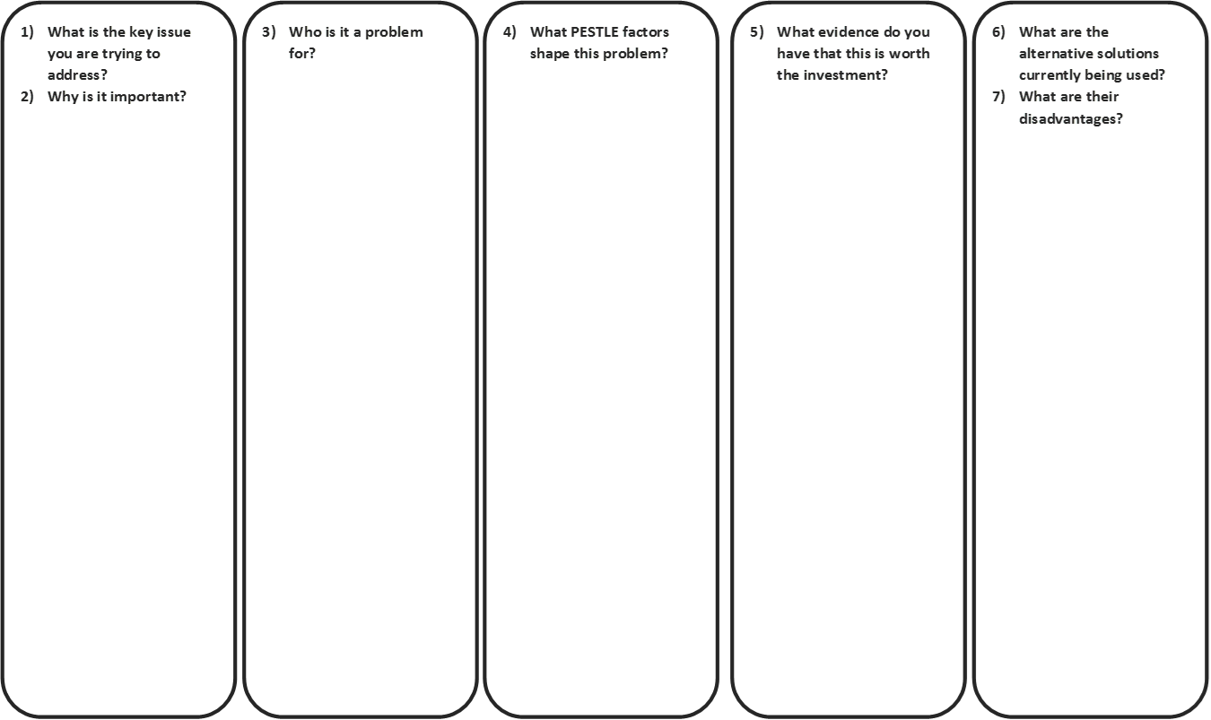
Define the problem
Use this exercise to define the social problem you are addressing and why it has not been fixed.

Slide 5



Key problem frameworks to align to
Consider whether the problem you identified is a problem that is recognised by others.

Slide 6
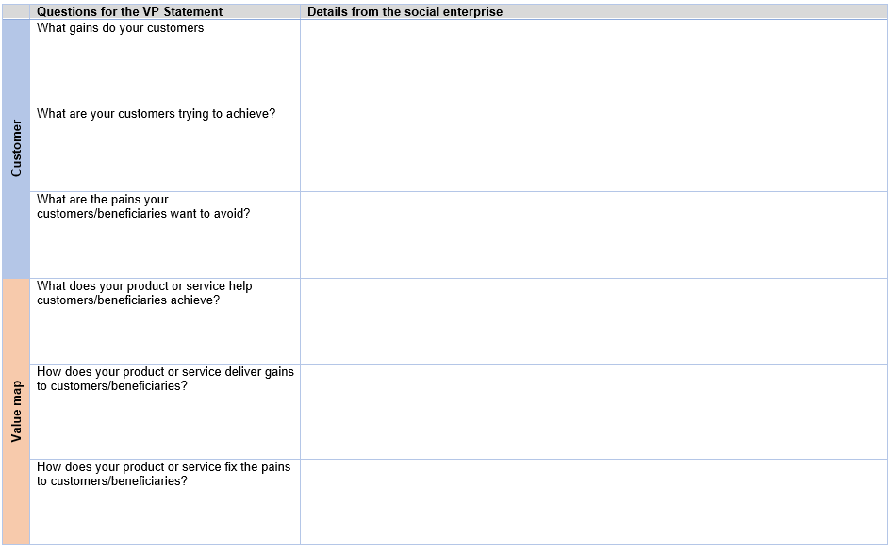
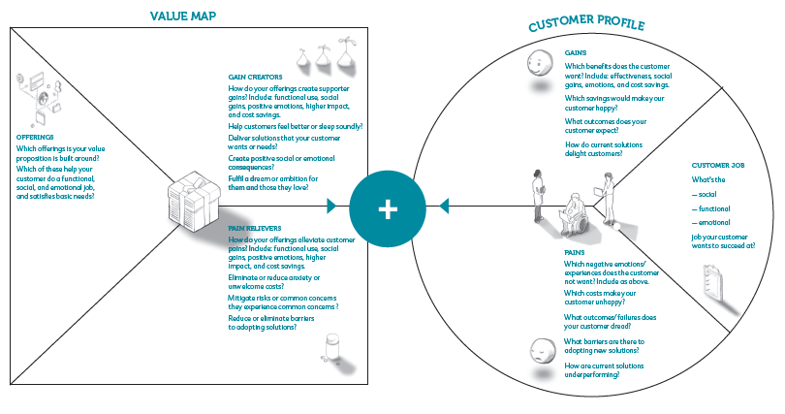
Social Value Proposition
Shows how your social enterprises fixes your customers problem and provides ‘gains’.
Written articulations

Slide 7
Theory of Change Development
Assumptions
Assumptions
If people change their behaviour then…
Difference in the user’s life
People will change their behaviours…
If people use the good/service then…
Change in the behaviour of the user
People will use the G&S…
Outputs of activities (goods & services)
If people access…
People will access…
If my enterprise does these…
Activities
I will deliver these…
If my enterprise has these…
Resources

Slide 8
KPI Development
Specific,
Measurable,
Attainable,
Relevant,
Timebound
Indicator
Target
No. of young people with new skills & increased confidence
By the end of 2017, 100 young people will have developed new skills and feel more confident and employable as a result of the project
Notes:
KPIs are important as they help you measure this change… the social impact that you have.
They can be used to test your assumptions…
And they can be used to show your achievements.

Slide 9
Types of KPIs
Quantitative
Qualitative
Quantities and amounts
Judgement, perception, emotion etc.
Cross reference
No. of customers reporting increased income as a result of our training.
Evidence that beneficiaries wellbeing has increased as a result of our support
Notes:
Generally there are 2 types of KPIs… quantitative and qualitative…
The quant are the numbers… they generally refer to numerical changes:
no. of people with X
Increased income of X.
Qualitative indicators tend to focus more on the judgement, feelings and perceptions of someone… they are subjective.
It is important to cross reference both and think about both being SMART!

Slide 10








Choosing Approaches and Tools
Pre-existing tools, data and methodologies (e.g. Lean Data Acumen, Most Significant Change, Wellbeing Index)
Forms, surveys
Focus groups
Secondary information
Interviews
Bespoke self-developed tools and methodologies
Diaries
Beneficiary photography
Social media
Art and creative approaches
Notes:
There are thousands of ways to collect data… the key is to think about what you want to know (e.g. your KPIs) and then think about the most appropriate method to get that information…
Does anyone have some suggested tools for collecting data and information from people?
Here are some of the popular ones…
It is important to think about how much time and effort you can put into designing these!
Because of that, it is good to think about data collection tools in 2 ways:
Do I develop them myself from scratch? This can be more bespoke but you might be reinventing the wheel.
Can I use someone else’s data or tools? You migh tnot be able to adapt it as much as your own… but they will often have had good investment and can be recognised by others.

Slide 11
Data Collection Planning
The Data Collection Planning Tool gives a step by step exercise of how to plan your data collection activities and to think about your analysis.

Slide 12
Wrap up
Any unanswered questions
Next steps agreed
Timelines agreed
Thank you

